Slide 1
Color Image Processing
Notes:
‹#›

Slide 2
What is color?
Selective emission/reflectance of different wavelengths
Notes:
‹#›

Slide 3
What is color?
Illumination
Reflectance
Notes:
‹#›

Slide 4
What is color stimuli?
X
Illumination
Reflectance
Notes:
‹#›

Slide 5
Types of Color Stimuli
‹#›

Slide 6
Perceived Color
The response generated by a stimulus in the cones gives the perceived color
Three responses
‹#›
Notes:
‹#›

Slide 7
Computations on Color
Very difficult using spectrums
Can we have some sort of coordinate space to define color?
Notes:
‹#›

Slide 8
Tristimulus Values
Integration over wavelength
λ=700
X = ∫C(λ)x(λ) = ∑ C(λ)x(λ)
λ
λ=400
λ=700
Y = ∫C(λ)y(λ) = ∑ C(λ)y(λ)
λ
λ=400
λ=700
Z = ∫C(λ)z(λ) = ∑ C(λ)z(λ)
λ
λ=400

Slide 9
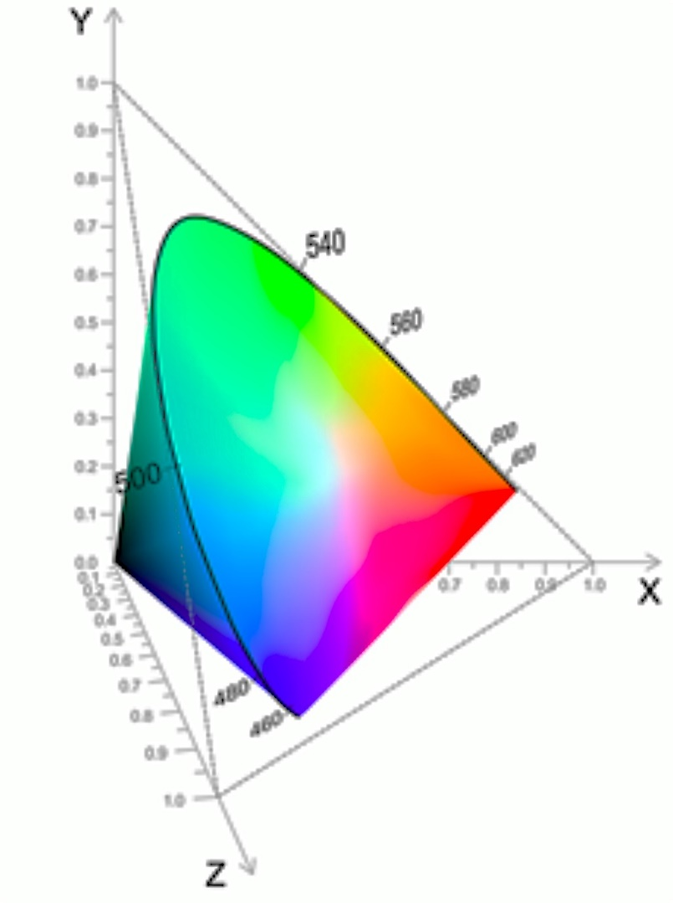
CIE XYZ Space
Real colors span a sub-set of the XYZ space
Two different stimuli can have same XYZ values
Metamerism
‹#›
Notes:
‹#›

Slide 10
Perceptual Organization of CIE XYZ Space
No physical feel as to how colors are arranged
How do brightness change?
How does hue change?
‹#›
Notes:
‹#›

Slide 11
What are the perceived properties?
Intensity
Sum of the spectrum
Energy under the spectrum
I = X+Y+Z
Hue
Mean wavelength of the spectrum
What wavelength sensation is dominant?
Saturation
Standard deviation of the spectrum
How much achromatic/gray component?
‹#›

Slide 12
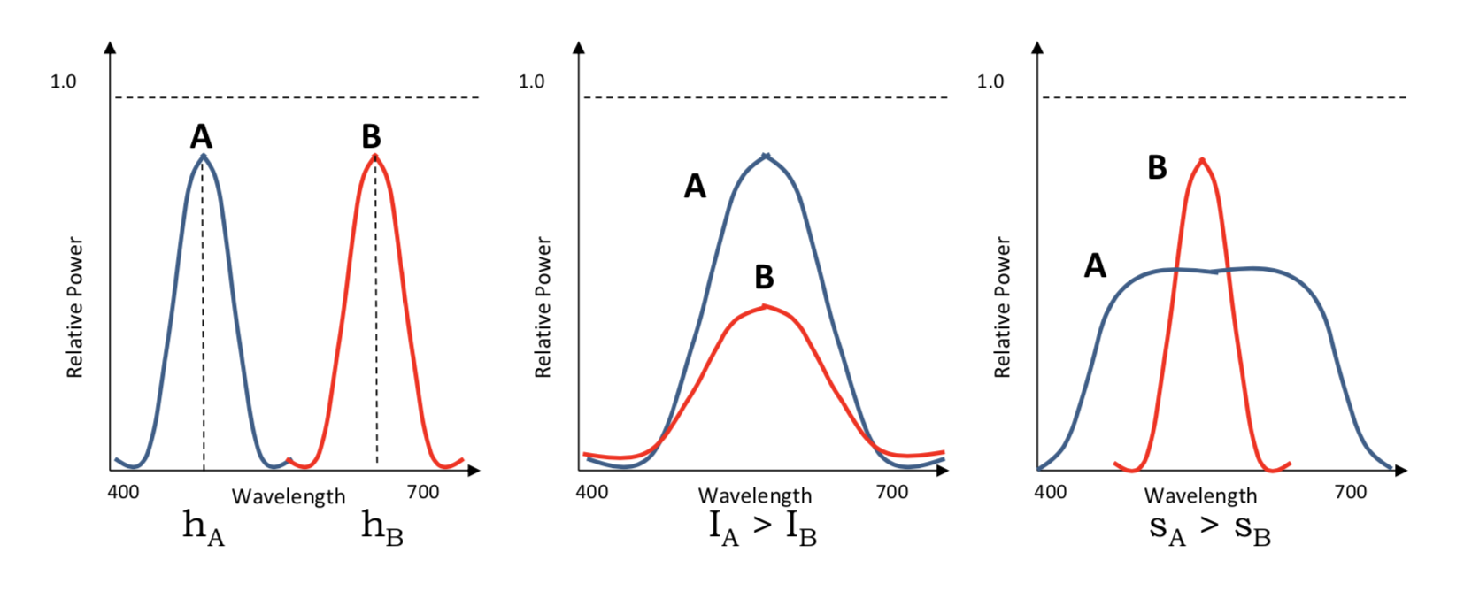
perceived properties
Left: A and B have same intensity but different dominant wavelength and therefore different hues.
Middle: A and B have the same hue but different intensities.
Right: A and B have the same hue but different saturations.
‹#›

Slide 13
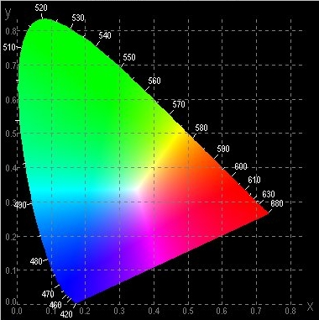
Chrominance
Chrominance – Hue and saturation
Chrominance (x,y) = (X/I, Y/I)
Chromaticity chart
Projection on a plane with normal (1,1,1)
Reduction of dimension
Similar to 3D to 2D in geometry
‹#›

Slide 14
What does this mean?
Scaling a vector (kX,kY,kZ)
(x,y) does not change
Each vector from (0,0,0) is an iso-chrominance line
Each vector map to a point in the chromaticity chart
‹#›

Slide 15
Chromaticity Coordinates
Shows all the visible colors
Achromatic Colors are at (0.33,0.33)
Why?
Called white point
The saturated colors at the boundary
Spectral Colors
White Point
‹#›

Slide 16
Chromaticity Chart
Exception is purples
Non-spectral region in the boundary
All colors on straight line from white point to a boundary has the same spectral hue
Dominant wavelength
White Point
‹#›

Slide 17
Chromaticity Chart
What happens here?
Complimentary wavelength
When mixed generate achromatic color
Purity (Saturation)
How far shifted towards the spectral color
Ratio of a/b
Purity =1 implies spectral color with maximum saturation
B
B’
b
P
a
White Point (W)
P
‹#›

Slide 18
Luminance
Perceived brightness
Based on eye’s response
Same brightness green looks brighter than blue or red
This is proportional to Y
‹#›

Slide 19
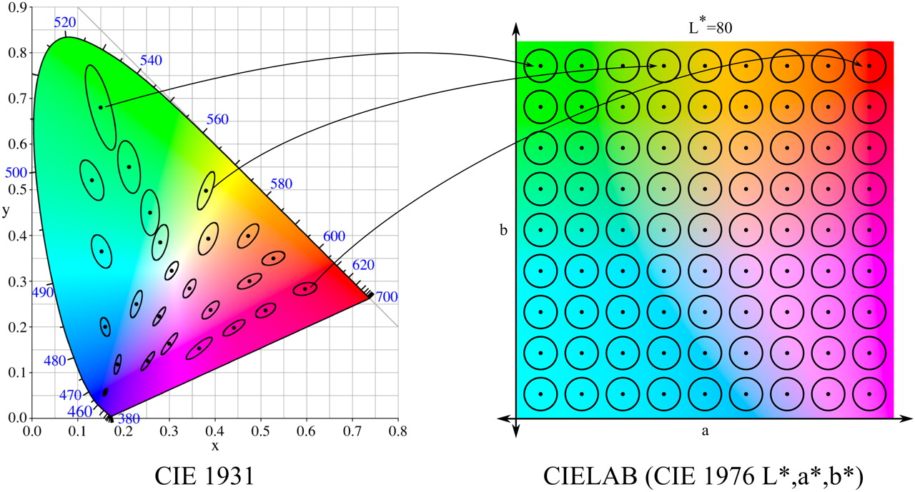
Perceptually Uniform Color Spaces
‹#›
Notes:
‹#›

Slide 20
Color Mixing
Additive Color Mixtures
Subtractive Color Mixtures

Slide 21
Additive
Additive color mixtures modeled by addition in XYZ space
When spectrums get added
Displays
C₁(λ)
C₂(λ)
Power
Wavelength

Slide 22
Subtractive
Subtractive like paint
Cannot be modeled by CIE XYZ space
C₁(λ)
C₂(λ)
Power
Wavelength
Notes:
‹#›

Slide 23
Additive Color Mixture
Add (X,Y,Z) coordinates
What does this mean in terms of brightness and chrominance?
Add brightness
Linear combination of chrominance in proportion of the brightness
‹#›
Notes:
‹#›

Slide 24
What is the RGB color?
Y
( X_{g} ,Y_{g},Z_{g} )
( X_{r} ,Y_{r} ,Z_{r} )
X
X = X_{r} X_{g} X_{b} i _{r}
( X_{b} ,Y_{b} ,Z_{b} )
Y = Y_{r} Y_{g} Y_{b} i _{g}
Z = Z_{r} Z_{g} Z_{b} i _{b}
Z
Notes:
‹#›

Slide 25
Color reproducibility
Only a subset of the 3D CIE XYZ space called 3D color gamut
Projection of the 3D color gamut on the same plane with normal (1,1,1)
Triangle
2D color gamut
Cannot describe brightness range reproducibility
Notes:
‹#›

Slide 26
Specification Protocols
Brightness or Luminance
2D gamut
Large if using more saturated primaries
Notes:
‹#›

Slide 27
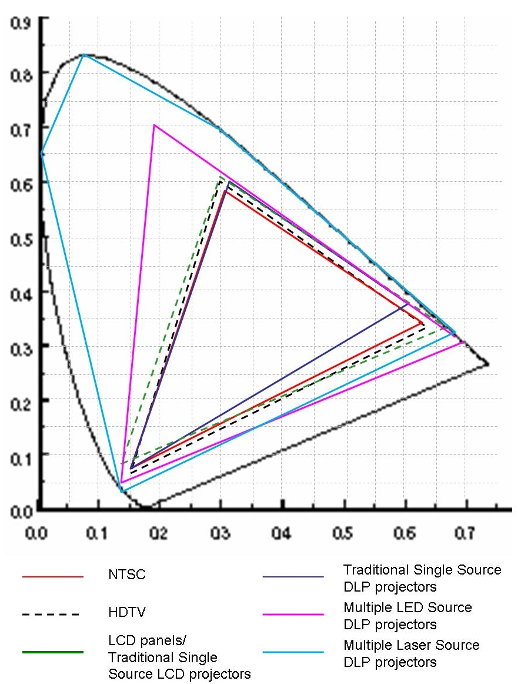
Current standards and devices

Slide 28
Gamut Transformation
Assume linear gamma
[X Y Z 1] ^{T} = M [R G B 1] ^{T}
Two devices
[X Y Z 1] ^{T} = M₁ [R₁ G₁ B₁ 1] ^{T}
[X Y Z 1] ^{T} = M₂ [R₂ G₂ B₂ 1] ^{T}
[R₂ G₂ B₂ 1]^{T} = M₂⁻¹[X Y Z 1]
= M₂⁻¹M₁[R₁ G₁ B₁ 1]^{T}
Notes:
‹#›

Slide 29
Gamut Transformation
How to get the matrix from the standard spec?
Given (Y,x,y) or (I,x,y) for the three vectors, you can compute (X,Y,Z)
(x. Y/y, Y, (1-x-y). Y/y)
(x.I, y.I, (1-x-y).I)
Does not change the color, finds the new coordinates when using the new basis
Notes:
‹#›

Slide 30
Problem
Notes:
‹#›

Slide 31
Problem: Out of Gamut colors
Notes:
‹#›

Slide 32
Gamut Matching
Find a common color gamut defined by R_{c}, G_{c}, B_{c}
Find the common function M_{c}
[X Y Z 1]^{T} = M_{c} [R_{c} G_{c} B_{c} 1]^{T}
For any device i
[R_{i} G_{i} B_{i} 1]^{T} = M_{i}⁻¹M_{c} [R_{c} G_{c} B_{c} 1]^{T}
Notes:
‹#›

Slide 33
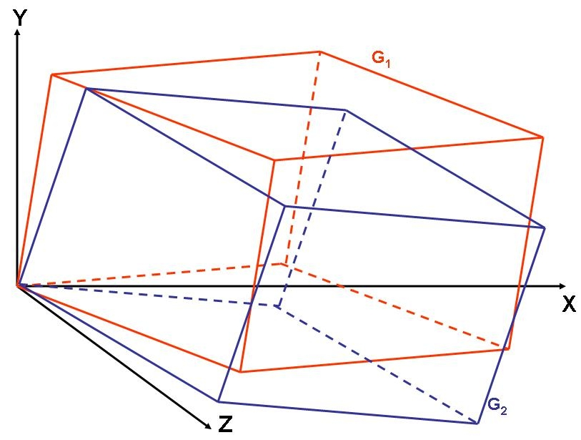
Two gamut
Notes:
‹#›

Slide 34
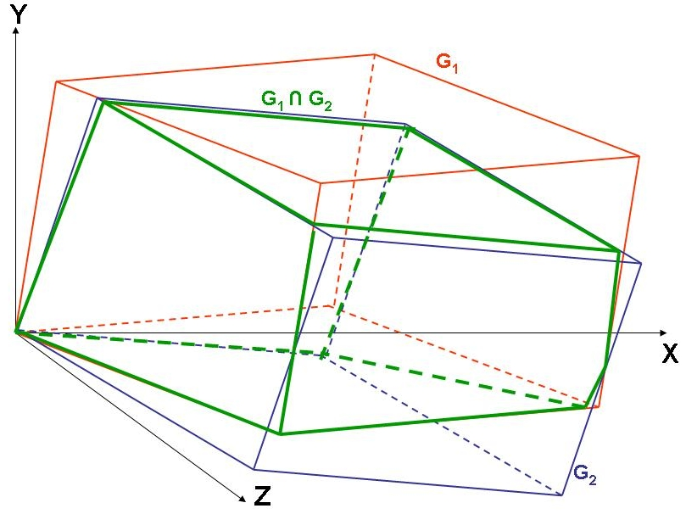
Find their intersection
Need not be a parallelopipped
Notes:
‹#›

Slide 35
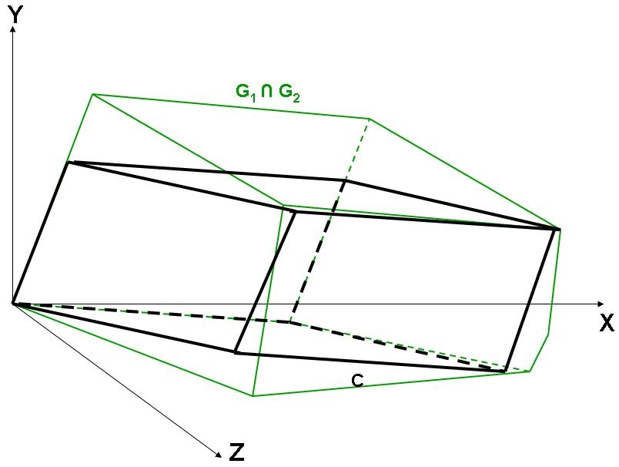
Find the common gamut
Notes:
‹#›

Slide 36
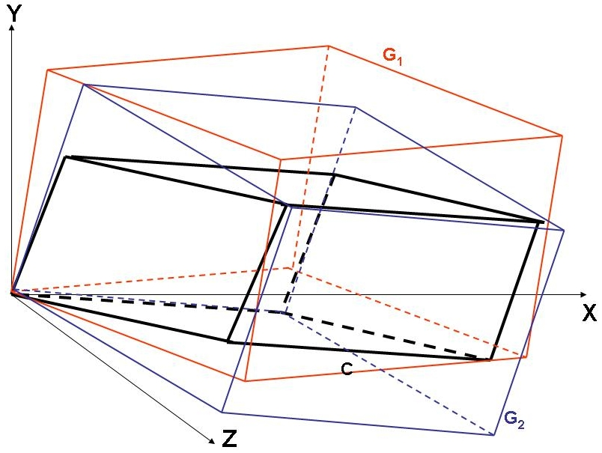
Find the mapping function

Slide 37
Gamut Mapping
Changing the actual colors
Mapping color in one gamut to another in the new gamut
If just dealing with two devices, may choose to move colors from one gamut to another
Notes:
‹#›

Slide 38
What is gamma function?
( X_{g} ,Y_{g},Z_{g} )
( X_{r} ,Y_{r} ,Z_{r} )
X = X_{r} X_{g} X_{b} h _{r} ( i _{r} )
( X_{b} ,Y_{b} ,Z_{b} )
Y = Y_{r} Y_{g} Y_{b} h _{g} ( i _{g} )
Z = Z_{r} Z_{g} Z_{b} h _{b} ( i _{b} )

Slide 39
Tone Mapping Operator
How the input value maps to output intensity
Affects brightness, contrast and saturation

Slide 40
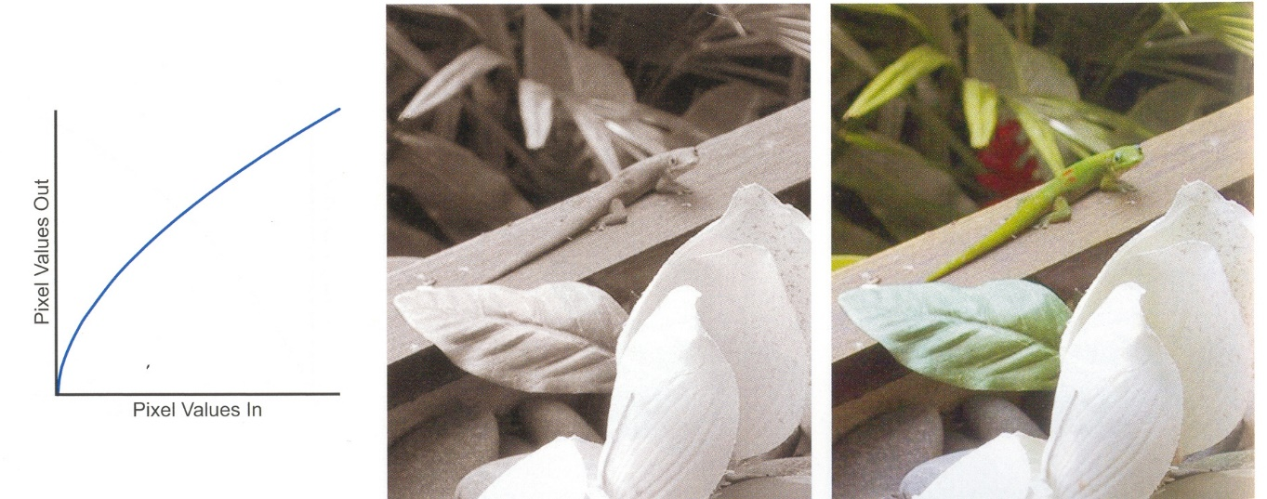
Tone Mapping Operator
How the input value maps to output intensity
Affects brightness, contrast and saturation

Slide 41
Transfer Function
Monotonic, smooth with no flat regions
Brightness and contrast controls

Slide 42
Image Correction

Slide 43
Color Balance
Relative proportions of primaries while forming a color
Affects hue, saturation and brightness
Can be changed by changing the transfer function

Slide 44
Color Balancing

Slide 45
Quantization
Digitization of color
Gray scale – infinite grays between 0 and 1
8 bit representation – 256 levels
A range of grays represented by a single value
Any value is assigned to one of k values
Choose number of levels and range of each level

Slide 46
Quantization Error
Uniform Quantization
Maximum Error = ½ Step Size
Q(g)
Quantization Error
Step Size
g

Slide 47
Is it constant across all levels?
Only when linear transfer function
Usually non-linear transfer function
Quantization error changes with input

Slide 48
Gamma Function
Usually a gamma transfer function
O = I^{γ}
Output Intensity
Display Gamma
Input Intensity

Slide 49
Non-Uniform Quantization
Note how quantization changes
Non-uniform step size
Maximum Error
½ of maximum step size
# of levels is the color resolution
# of bits
Display Gamma
Output Intensity
Input Intensity

Slide 50
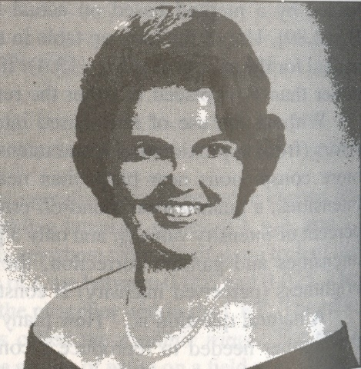
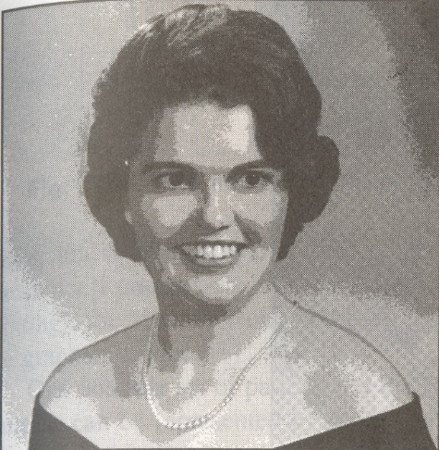
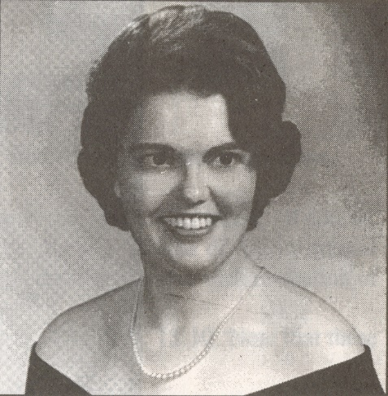
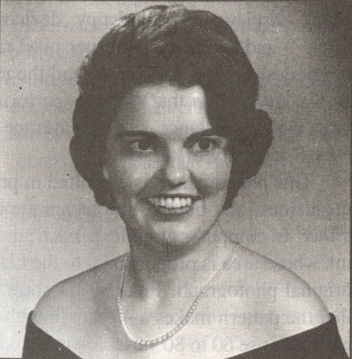
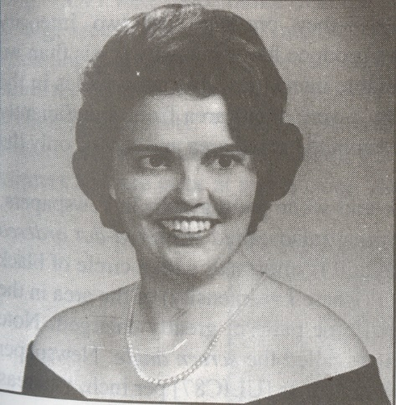
Color Resolution
Analog Image
4 Steps
8 Steps
16 Steps
Quantization Artifacts
64 Steps
32 Steps

Slide 51
Dithering
What if the color resolution is low?
Newsprint – Bi-level, only black and white
Can we expand the # of colors?
Spatial integration of eye
Trading off spatial resolution for intensity resolution

Slide 52
Dithering
0 2
1 3
Represented by a dither matrix
nxn pixels, bi-level intensity, can produce n²+1 intensities
If more than two levels – k levels
n². (k-1) +1
Used for increasing the color resolution

Slide 53
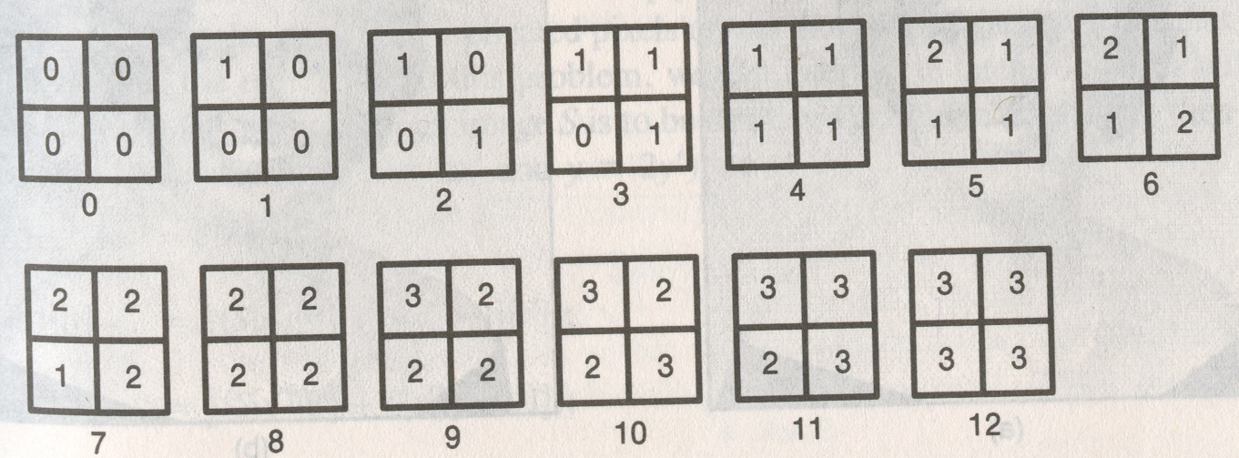
Dithering
If more than two levels – k levels
n². (k-1) +1
For k = 4 (0,1,2,3) and n=2

Slide 54
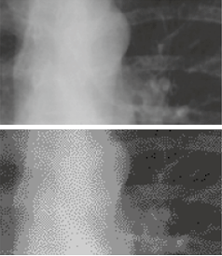
Examples
Loss of tone and details
(Intensity and Spatial Resolution)

Slide 55
Subtractive Color System
Layers of cyan, yellow and magenta dyes
Absorb red, blue and green light
Depends on the illuminant
Act as absorption filter
Ideally block filters
Overlaying all the three dyes absorbs all wavelengths creating black

Slide 56
Creation of a color
CMY = (1, 1, 1) – RGB
(0.25, 0.5, 0.75) = (1, 1, 1) – (0.75, 0.5, 0.25)
This works only for block filters

Slide 57
Real Fiilters
Are not block filters
Cross talk across different filters
Due to ink impurities
Grays should be formed by equal amount of three primaries
Seldom happens

Slide 58
Why use black?
Better contrast
Use of inexpensive black in place of expensive colored dyes
Superimposing multiple dyes cause tearing of wet paper
K for key
Not an independent primary
Hence makes dark colors darker

Slide 59
Gray Balancing
The first step in printing is to decide how much of GCR to be used for the neutral grays
However, every gray needs to be decided separately
Called gray balancing
Usually done by iteration
No simple tristimulus model to decide components

Slide 60
Dependency on Content
Discussed content independent
Can also be done by understanding the color distribution of the particular content
Usually non-linear

